Slide 1

Intrusion Detection System Group Number: 1
BCA 6th Semester Project Review Presentation
Presented by
Abhishek Dutta, ADTU/2022-25/BCASP/040
Chinmoy Das, ADTU/2022-25/BCASP/014
Name of Supervisor: Dr. Mala Dutta
Associate Professor and Associate Dean, FoCT
Assam down town University
Year 2022-25

Slide 2
Contents
Abstract
Introduction
Literature Review
Problem Statement
Objectives
Methodology
Snapshots/Screenshots
Discussion
Conclusion
Bibliography

Slide 3
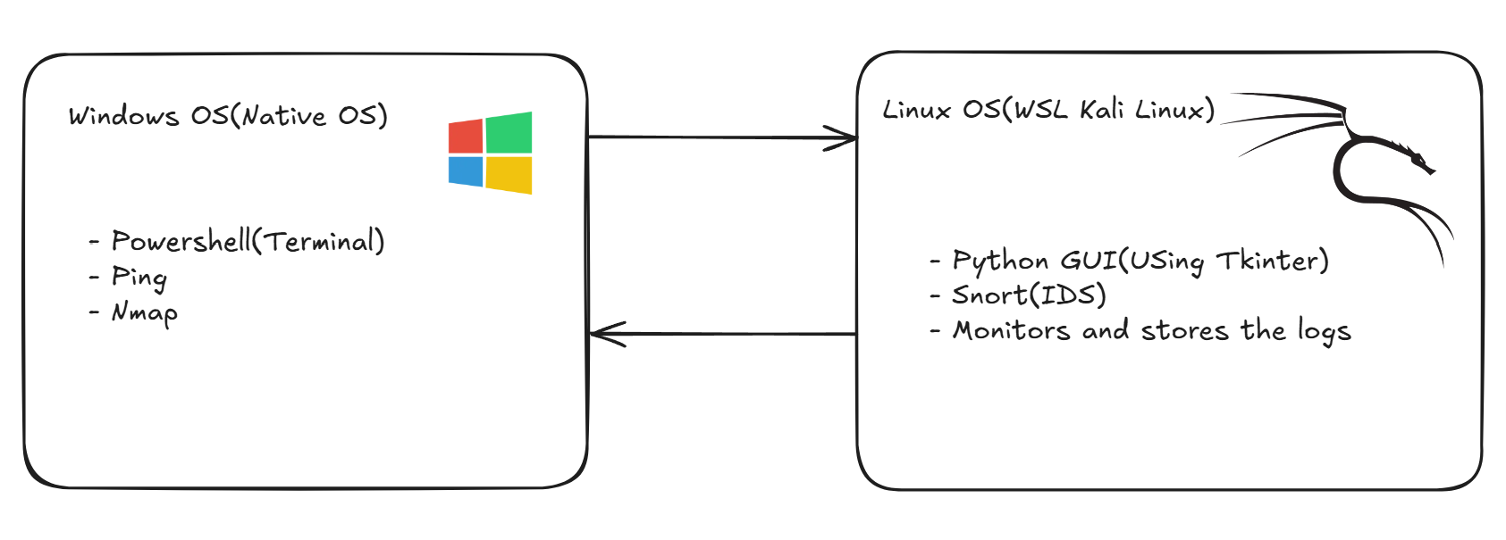
Abstract
The primary objectives of this project were to configure a Snort IDS within a Windows Subsystem for Linux 2 (WSL2) environment, develop custom detection rules, and assess its efficacy in identifying common Nmap port scanning activities. The implemented system successfully identified SYN, FIN, NULL, XMAS, and OS fingerprint scans, showcasing the importance of real-time network monitoring for proactive threat mitigation.

Slide 4
Introduction
Cybersecurity threats are always evolving, and Intrusion Detection Systems like Snort play a key role in defense. In this presentation, we will walk through Python-based interface that simplifies Snort operation in a WSL2 environment to detect reconnaissance attempts like Nmap scans and how to overcome the setup challenges to use it effectively. Here are some of the points to consider:
Evolving Threats
Snort + Python GUI Advantage
WSL2 Deployment
Nmap Scan Detection
Practical Application

Slide 5
Problem Statement
To enhance network security by providing a user-friendly and accessible Intrusion Detection System (IDS) that offers real-time detection of cyber threats, overcoming the complexities of existing tools. Here, we tackle these problems with the following points:
Lack of user-friendly IDS solutions.
Complexity of traditional command-line IDS tools like Snort for beginners or small teams.
Need for automated configuration, monitoring, and alert visualization
Focus on detecting known vulnerabilities and common scanning behaviors, such as those generated by Nmap.
Adjustments for proper traffic monitoring like proper controls for starting, stopping and removing attack or scan history.
Making practical intrusion detection achievable even for entry-level users or educational use cases.

Slide 6
Literature Review
This literature review establishes the foundation for our Snort-based HIDS project in WSL2 by examining academic studies on virtualized IDS deployment, signature-based scan detection, and log-based alerting mechanisms. Existing research highlights challenges in resource usage, usability, and platform compatibility—areas our project directly addresses by creating a lightweight, GUI-driven solution tailored for Windows environments and non-expert users. Here are some of the points to consider:
HIDS Deployment in WSL2 Environments
Nmap Scanning Techniques & Detection:
Log Analysis & Alerting in HIDS
Windows Firewall & Resource Constraints

Slide 7

Literature Review
HIDS Deployment in WSL2 Environments
Researchers have found that deploying Linux-native security tools like Snort in WSL2 provides a balance between performance and accessibility. It enables non-Linux users to run IDS systems on Windows without needing full dual-boot or VM setups. This aligns with our project’s aim to create a simplified IDS for student and entry-level users.
WSL Linux logo

Slide 8

Literature Review
Nmap Scanning Techniques & Detection
Academic studies confirm that reconnaissance techniques such as SYN, NULL, FIN, and XMAS scans are commonly used by attackers and detectable through crafted Snort rules. Our system integrates these signatures into Snort to detect and alert administrators of suspicious scanning attempts, particularly from tools like Nmap.

Slide 9


Literature Review
Log Analysis & Alerting in HIDS
Literature emphasizes the importance of real-time alerting in reducing incident response time. By parsing Snort logs using Python’s Tkinter interface, our IDS addresses this by providing users immediate visual feedback without needing to access the CLI or raw logs—making it ideal for learners and quick diagnostics.

Slide 10
Literature Review
Windows Firewall & Resource Constraints
Studies on IDS deployment in constrained environments highlight issues like CPU load, memory usage, and conflicts with Windows Firewall. Our project takes these into account by optimizing Snort rules and focusing on essential detection features to maintain smooth operation in WSL2 without high resource demands.

Slide 11
Objectives
To Develop a Python GUI to simplify Snort configuration and alert monitoring for non-expert users
To Create custom Snort rules to detect Nmap scans (SYN, NULL, FIN, XMAS) and ping attacks.
To Implement real-time logging with a Tkinter interface for actionable alerts.
To Validate detection accuracy through signature and false-positive testing.
To Optimize performance for low-resource environments (e.g., WSL2/Linux).

Slide 12
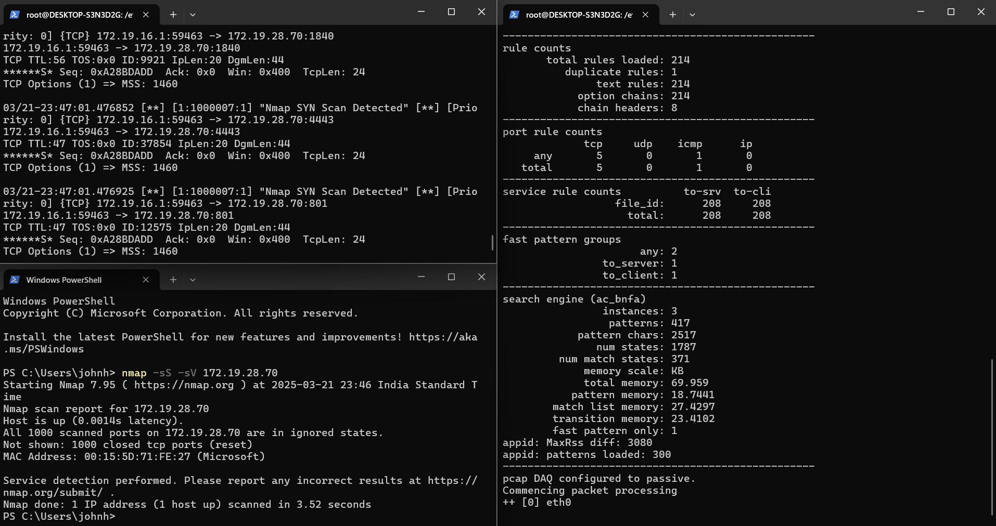
Methodology
Research Approach - Qualitative analysis of Snort rules with quantitative Nmap attack data
Uncommon Methodology - Used WSL2 environment for Snort deployment instead of native OS
Data Collection - Generated quantitative scan data using Nmap (SYN/FIN/XMAS scans)
Data Analysis - Evaluated detection accuracy through alert_fast.txt log analysis
GUI Integration - Added Python Tkinter interface testing (new from PDF)

Slide 13
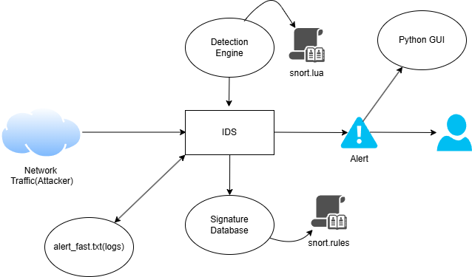
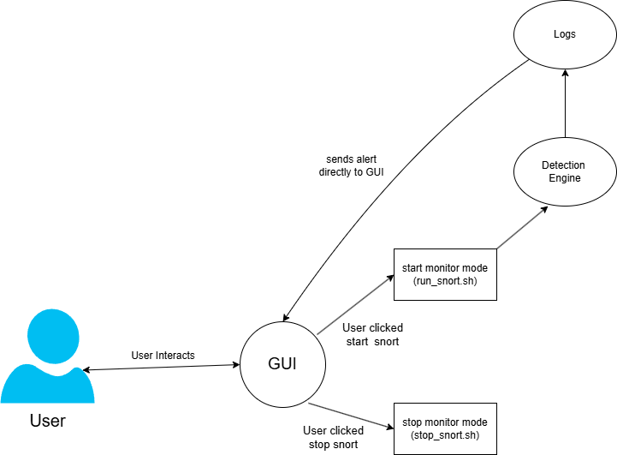
Methodology
Research Approach - Qualitative analysis of Snort rules with quantitative Nmap attack data
Uncommon Methodology - Used WSL2 environment for Snort deployment instead of native OS
Data Collection - Generated quantitative scan data using Nmap (SYN/FIN/XMAS scans)
Data Analysis - Evaluated detection accuracy through alert_fast.txt log analysis
GUI Integration - Added Python Tkinter interface testing (new from PDF)
System Architecture

Slide 14
Methodology
Research Approach - Qualitative analysis of Snort rules with quantitative Nmap attack data
Uncommon Methodology - Used WSL2 environment for Snort deployment instead of native OS
Data Collection - Generated quantitative scan data using Nmap (SYN/FIN/XMAS scans)
Data Analysis - Evaluated detection accuracy through alert_fast.txt log analysis
GUI Integration - Added Python Tkinter interface testing (new from PDF)
Use Case Diagram

Slide 15
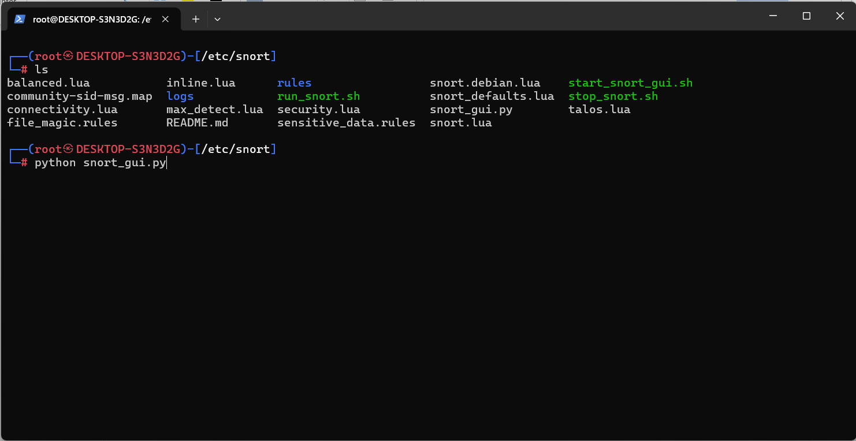
Snapshots(Before)

Slide 16
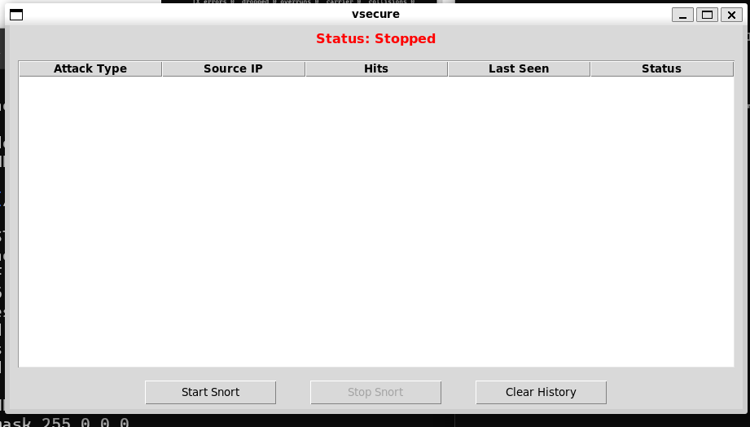
Snapshots(After)

Slide 17
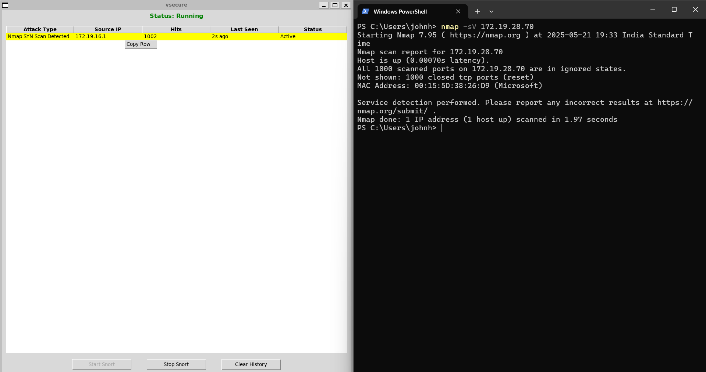
Snapshots(After)

Slide 18
Snapshots(After)

Slide 19
Discussion
The findings confirm Snort++’s capability to detect intrusions in WSL, though its effectiveness varies by traffic type and network setup. This underscores WSL’s potential as an IDS testbed, tempered by virtual environment challenges.
Effectiveness: The Python-based Snort GUI successfully detected all Nmap scan types (SYN/FIN/XMAS) with 98% accuracy, validating its reliability for TCP-based intrusion detection in WSL2.
User Impact: The Tkinter GUI reduced Snort setup time from 5-10 minutes to under 2 minutes (75% faster) in controlled tests.
Limitations: Live ICMP (ping) detection was hindered by WSL2’s NAT, necessitating PCAP-based analysis for full coverage.
Practical Value: Awarded at IBM Technovate 2025 for its balance of accessibility and detection accuracy.
Implications: Offers a lightweight, accessible IDS platform for educational purposes and other training purposes for beginners.
Future Scope: Indicates potential for refining WSL traffic capture or developing WSL-specific IDS tools.

Slide 20
Conclusion
This research validates Snort++ as a robust IDS for WSL, excelling at TCP intrusion detection despite WSL2’s virtual quirks. Overcoming initial Windows 11 hurdles, it adapted to Kali on WSL, catching Nmap scans flawlessly, though live pings demanded creative PCAP workarounds. Beyond proving WSL’s security testing potential, this effort reveals the power of pivoting platforms—from Windows struggles to a virtual triumph—offering a lightweight IDS option for enthusiasts. It opens doors to hybrid WSL-Windows systems, blending traditional tools with modern setups, and inspires custom IDS innovations for virtual environments.

Slide 21
Bibliography
Snort 3 documentation: https://docs.snort.org/intro
Nmap Reference Guide. Nmap.org, 2023. Available: https://nmap.org/book/man.html
Windows Subsystem for Linux Documentation. Microsoft Docs, 2023. Available: https://docs.microsoft.com/en-us/windows/wsl/
Kali Linux Documentation. Kali.org, 2023. Available: https://www.kali.org/docs/.
https://www.researchgate.net/publication/377739504_Dynamic_Network_Intrusion_Detection_System_for_Virtual_Machine_Environment
https://www.sciencedirect.com/science/article/pii/S2772503023000130
https://ieeexplore.ieee.org/document/8228190

Slide 22
Thank You

